Slide 1

Social Media
Rest Api
Members:
Shivam Gupta
Aditi Tandel
Jay Awale
Karthik
Tanusha
Varun Bhatia

Slide 2
Problem Statement
With each increasing day ,the Internet has become more pervasive in our lives. Most of the daily activities have gone online .In such a scenario ,the role of social media becomes more and more important ,then ever before. From a person's daily life routine ,to weather information and even emergency and other essential services can be accessed on social media.
Through this application, users should be able to connect to people ,send a friend request ,accept a friend request sent to him , share thoughts ,post comments ,share images ,view images, share and view status ,access an emergency service.
Create groups and forums over specific topics and allow users to join those groups and forums and post comments .
The system should allow for likes, dislikes ,comments .Also allow a user to unfriend or block other users from his group, page or friend list.

Slide 3
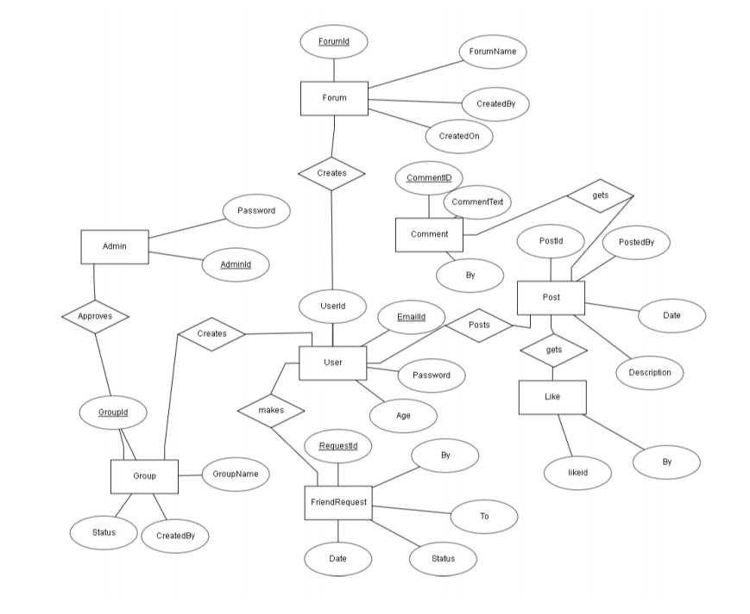
E-R Diagram

Slide 4
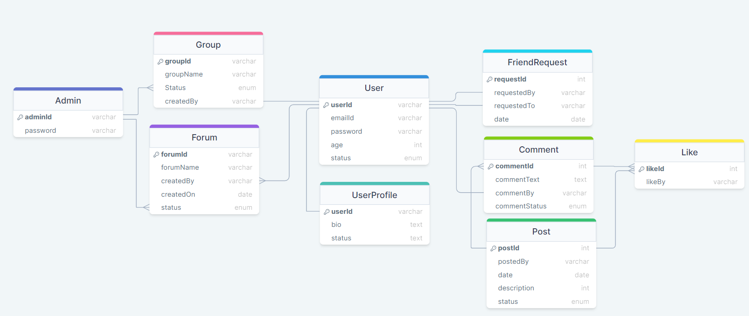
Database Diagram

Slide 5
User Stories - User Module
User should be allowed to register
User should be allowed be authenticated through login id and password .The session should end where user logs out or after a set time
User should be allowed to see registered users
User should be allowed to search for a specific user, through a search operation
User should be allowed to send a friend request to other users
User should be allowed to view pending friend request and accept or reject friend request
User should be allowed to see friend list and send a message to a friend, unfriend other users from his friend list
Users should be allowed to create groups and forums and send requests to selected users to join our forum. He/She should also be allowed to remove people from groups or forums
User should be allowed to create and edit a user profile along with his registration and allow status to be shared from that profile
User should be allowed to place likes over other person's Comments on his friend list and can also place comments
Create crud operations for post and add likes and comments to Post.

Slide 6
User Stories - Administration Module
Administrators can view users registered. Register a new user himself, add or remove users from the app.
Administrator can block users ,comments and posts.
Administrator can add or remove new groups or forums.
New groups or forums will be visible only after administrator’s approval.

Slide 7
Thank You!
Moving forward to demonstration

